Slide 1
Django Rest API

Slide 2
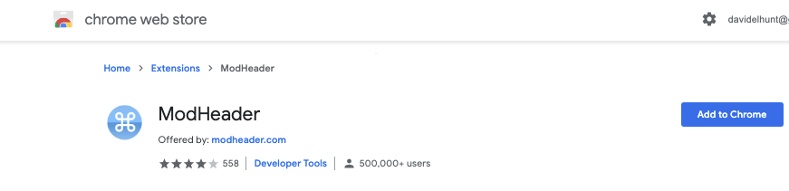
Install Modheader for chrome
ModHeader

Slide 3
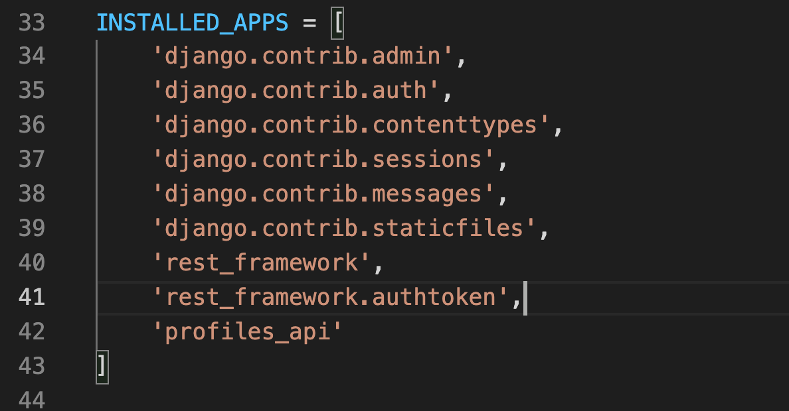
Add your frame works and your app

Slide 4
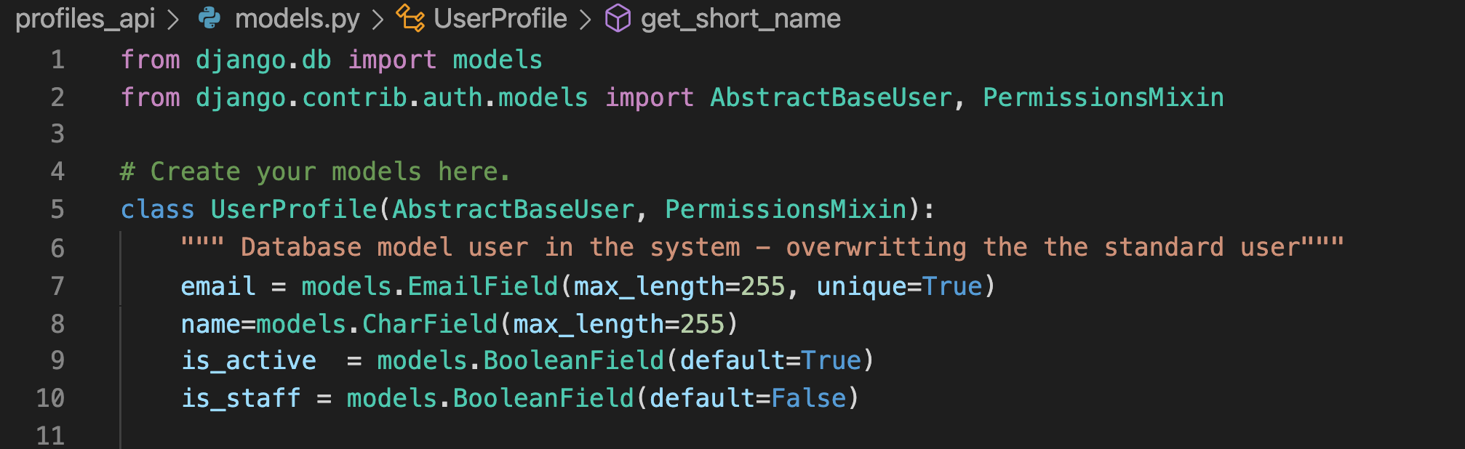
Create our user database model

Slide 5
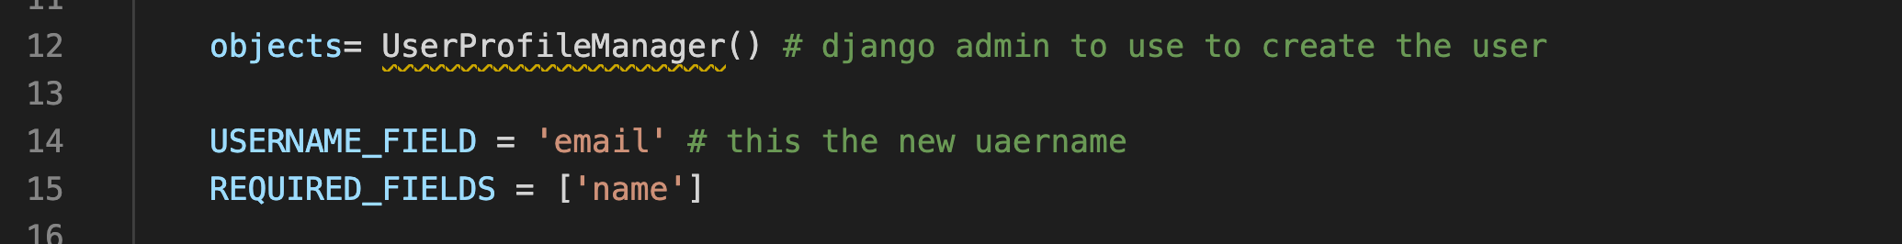
Create our user UserProfieManager

Slide 6
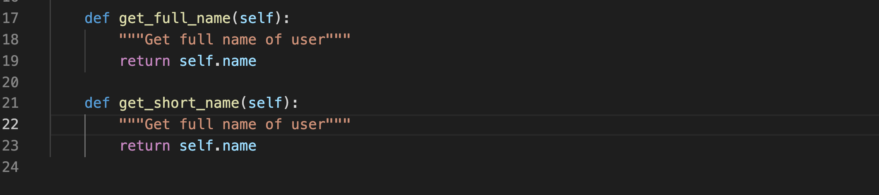

Slide 7
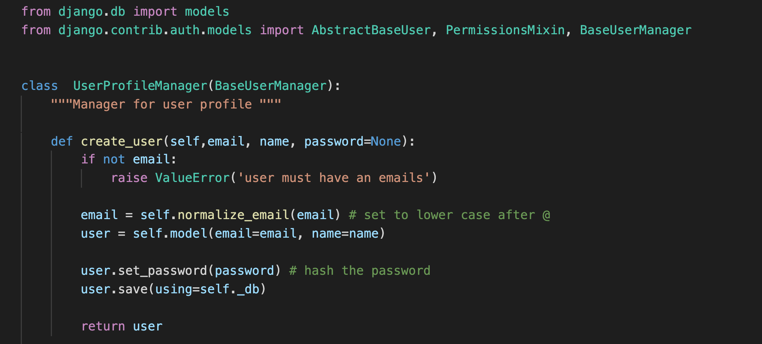

Slide 8
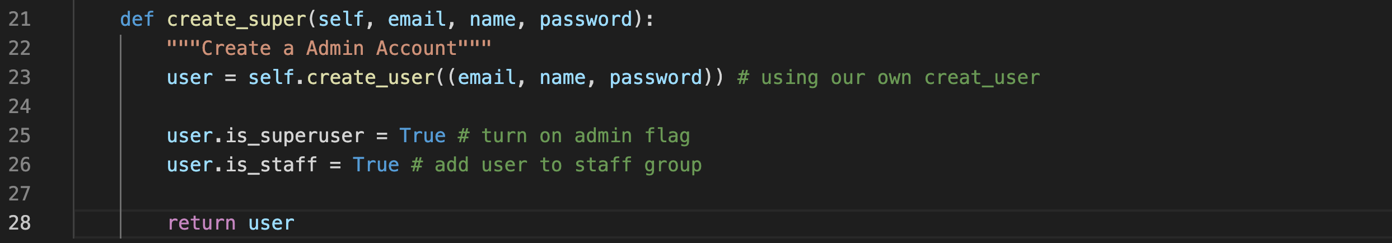

Slide 9
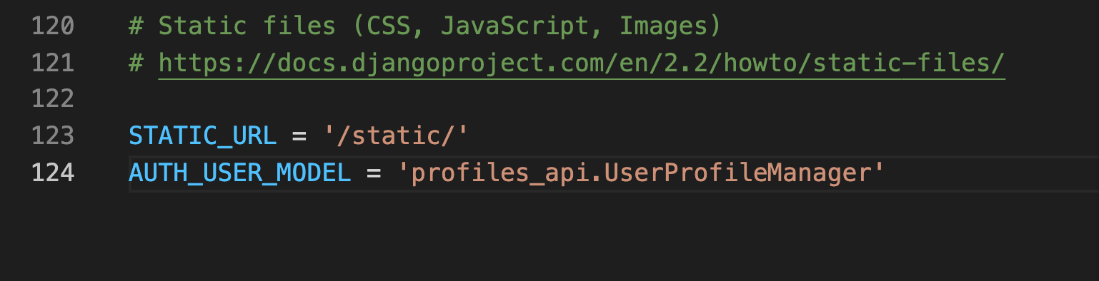
Add the model manager

Slide 10
Migrate out additions
python manage.py makemigrations
python manage.py migrate

Slide 11
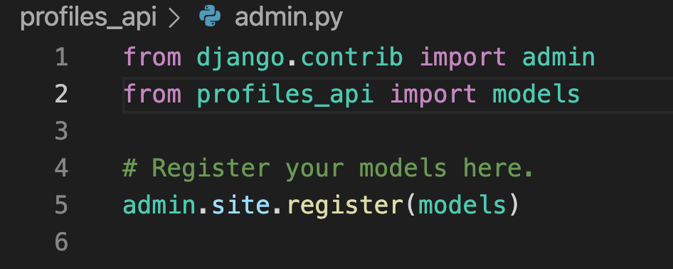

Slide 12
Enable Django Admin
python manage.py createsuperuser

Slide 13
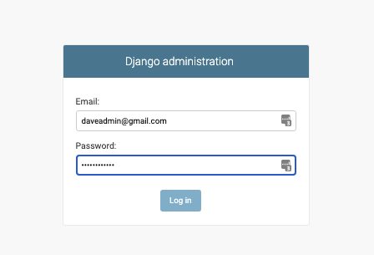
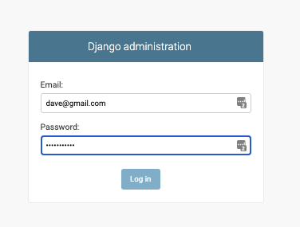
Enable Django Admin
http://127.0.0.1:8000/admin/
Notes:
Password = Password123

Slide 14
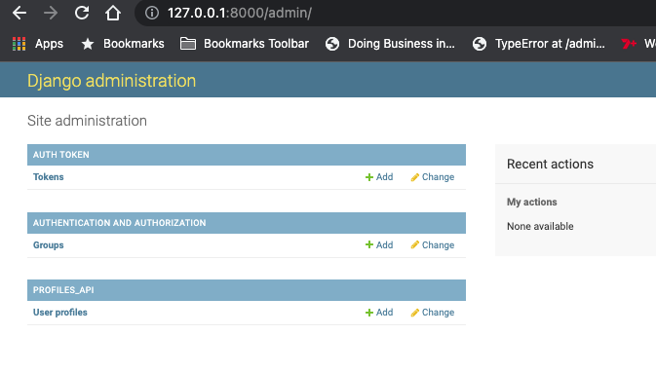
Note Custom users

Slide 15
APIVIEWS
APIVIEWS – basic
Describe logic to make API endpoints
HTTPS
GET
PATCH
POST
PUT
DELETE

Slide 16
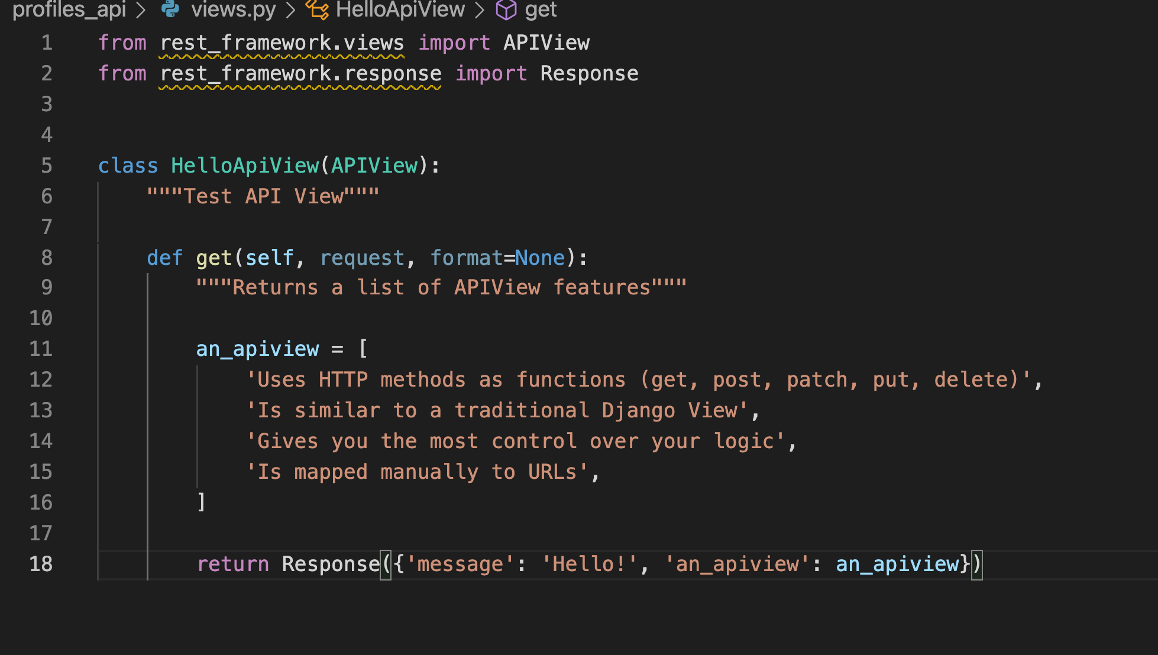
Add APIView to views.py

Slide 17
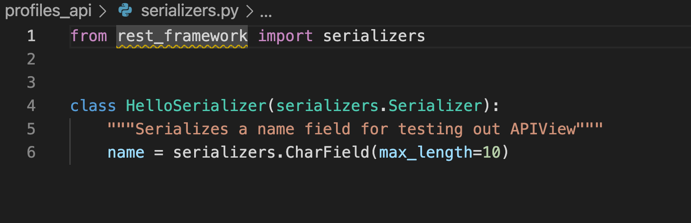
Add new file serializers.py

Slide 18
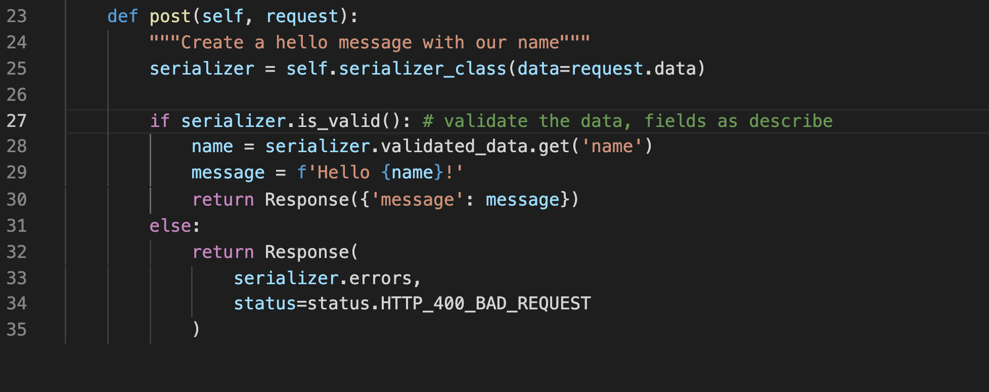
Add the POST

Slide 19
Add the PUT, PATCH DELETE functions

Slide 20
Viewsets
Good for common database functions

Slide 21
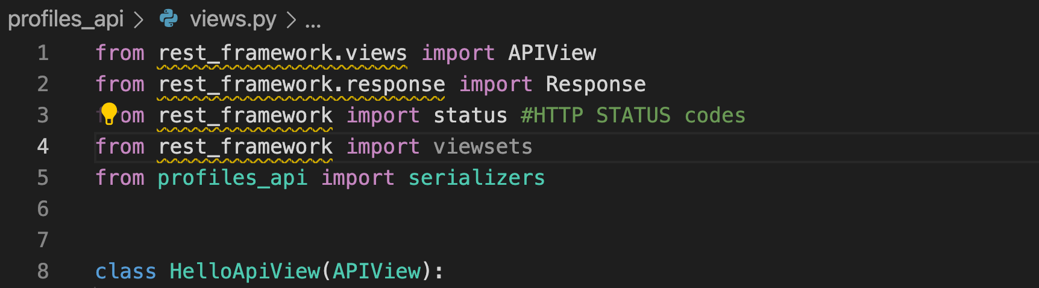
Do a viewsets import

